Slide 1
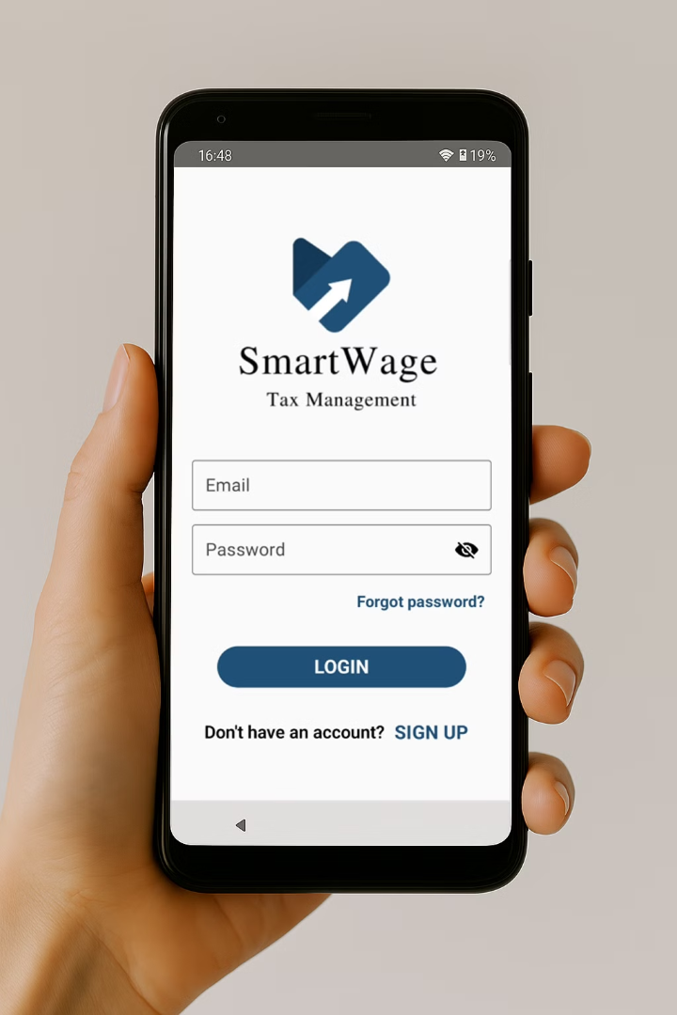
SmartWage
Tax Management
A mobile app to simplify Irish tax calculations!
Dorset College Dublin - Final Project - BSC30924
Developers :
Supervisor :
Filipe Lutz - 25956
WenHao Fu
Vinicius Miranda - 70973

Slide 2
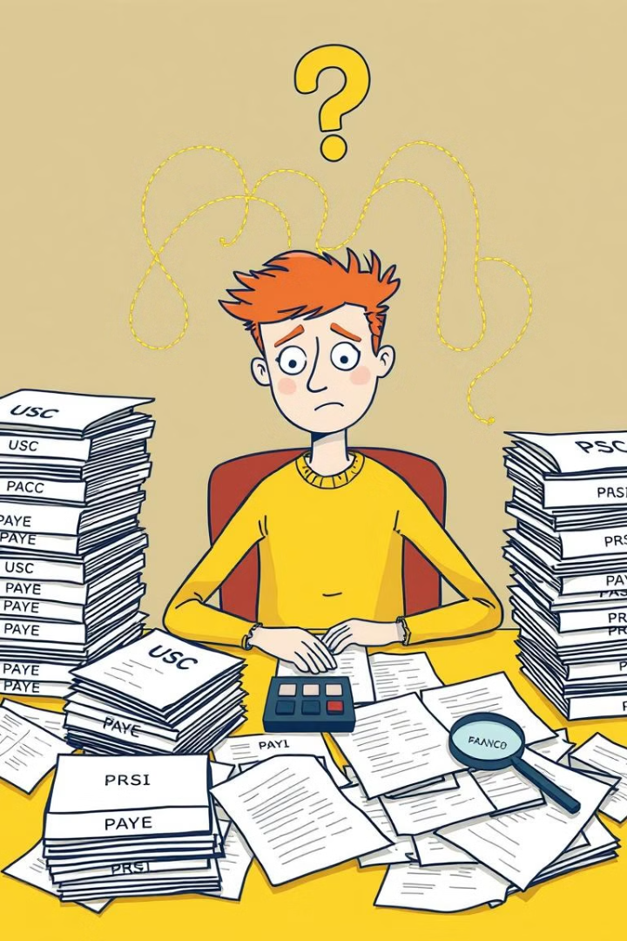




The Problem:
Tax Calculation Complexity
Complicated Tax System
Irish taxes can be difficult to understand, especially for those with multiple income sources
Lack of Clarity
Employees struggle to estimate their actual tax liability
Stress and Confusion
Uncertainty about tax obligations can lead to financial stress

Slide 3
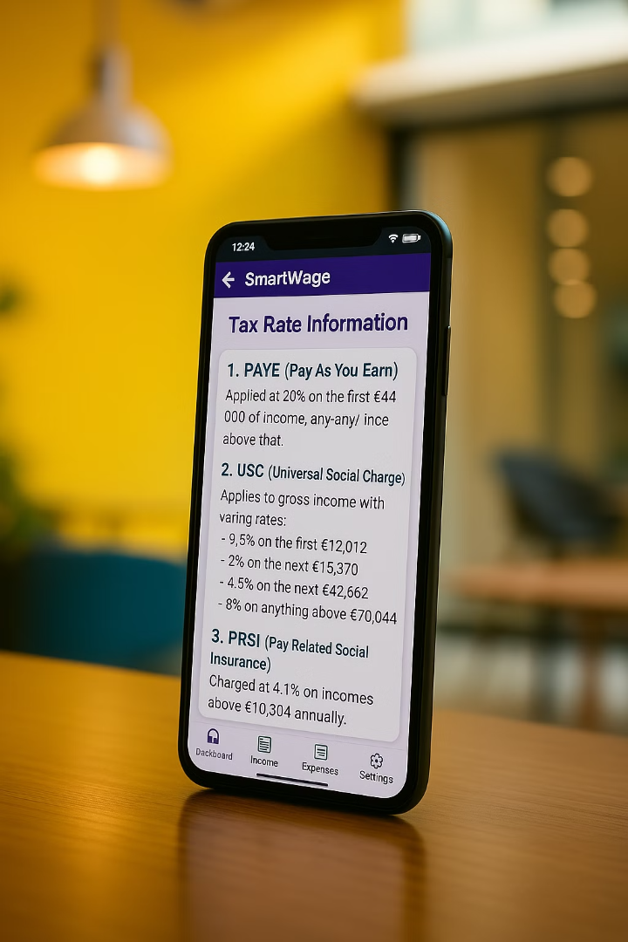
The Solution:
SmartWage Mobile App
Tax Breakdown
Instantly calculates tax due based on Revenue guidelines (PAYE, USC, PRSI and Tax Credits)
User-friendly Interface
Easily add multiple income and expenses
Tax Estimation
Enables users to understand how much tax they may have under or over paid

Slide 4



Project Motivation
Tax Complexity:
1
Hundreds of millions of Euro in tax rebates goes unclaimed in Ireland every year
Market Gap:
2
No existing mobile app for Irish tax calculation
Social Good:
3
The app help employees to make informed financial decisions and understand their tax liability
"As students working multiple part-time jobs, we found it difficult to understand how Irish income tax is calculated and when we could avail of tax relief. Once we realised that there was no mobile app to help us, we built one"

Slide 5
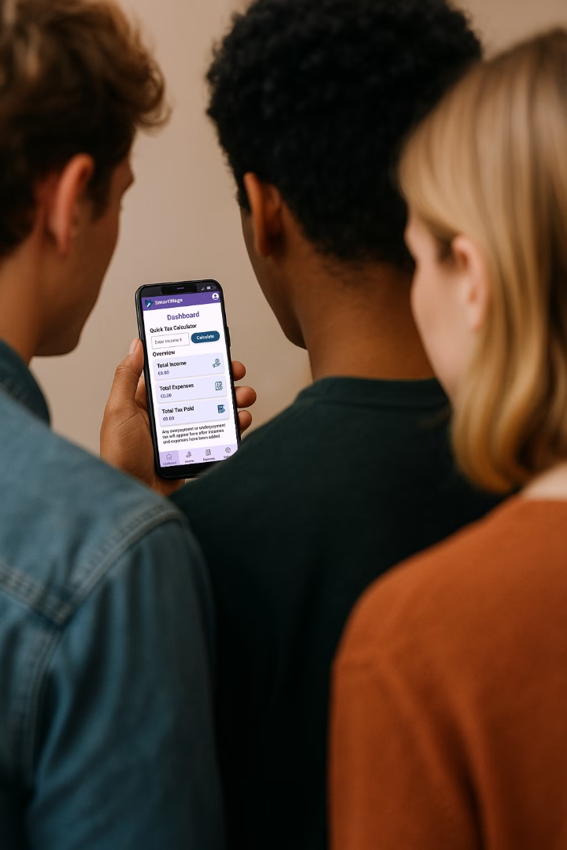


Target Audience
Students
Working Part-time
(Often have more than one job)
Employees
Seeking financial clarity

Slide 6
Building SmartWage
Tech Stack
Development
Tax Rules
Frontend: Kotlin + Jetpack Compose
Agile approach
Revenue.ie guidelines
Backend: Firebase + Room DB
UI/UX-driven development
Tax Rate 2025
Authentication: Firebase Auth
Testing

Slide 7
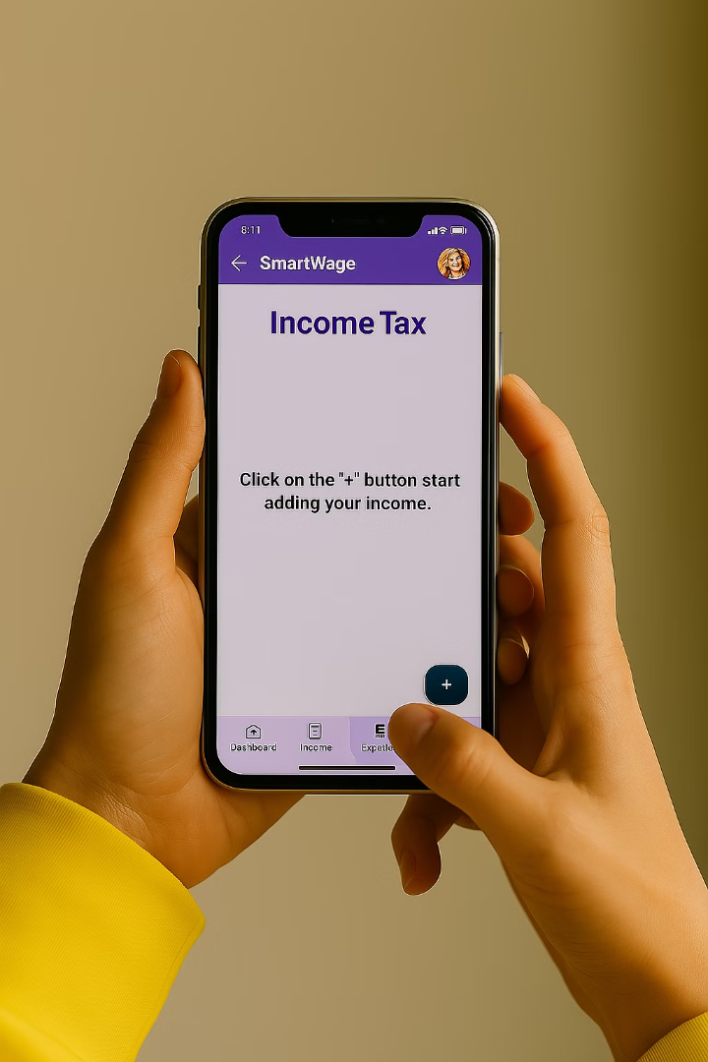




Live Demo
Income Input
Enter payslips with gross pay and taxes paid
Expense Input
Enter rent or tuition fee paid, if applicable
View Tax Breakdown
See expected tax amount and net pay instantly
Get Insights
Understand over/underpayment of tax

Slide 8

Project Timeline
Future Implementations
5
Two-Factor
Authentication
1
Research
6
PDF document
exports
2
Design & Prototyping
7
Real-time
alerts
3
Development
8
Payslip
Scanner
4
Testing

Slide 9
We hope this presentation was not too taxing
Thank you for your time
Do you have any questions?

